Slide 1
CALL
BACK

Slide 2
CaLL
bAcK

Slide 3
CALL
BACK

Slide 4
joswellmaxeph.github.io/callback/TeamSite/

Slide 5
AGENDA
Presentation Time
Background
Team Dynamics
Production Timeline
Parameters & Constraints
Stuff We Gotta Do
Discussion Time
Rewrite
Song Arrangements
Casting / Auditions
Production
Additional Crew
Scheduling

Slide 6
CALLBACK BACKGROUND
I have been writing this musical since age 12
That’s not literally true
What is true is that every song and story I have ever written has led directly to this moment
This show is me
This show is my life’s work

Slide 7
THE SHOW
adjective, not noun
adjective, not noun
CALLBACK is an original comedy musical.
An aspiring comedian gets the opportunity of a lifetime when a streaming service holds local auditions.
This show is about wanting to put your exact full self on display and be seen, understood, and loved for who you are
alt titles include - Live, Laugh, Love: The Musical

Slide 8
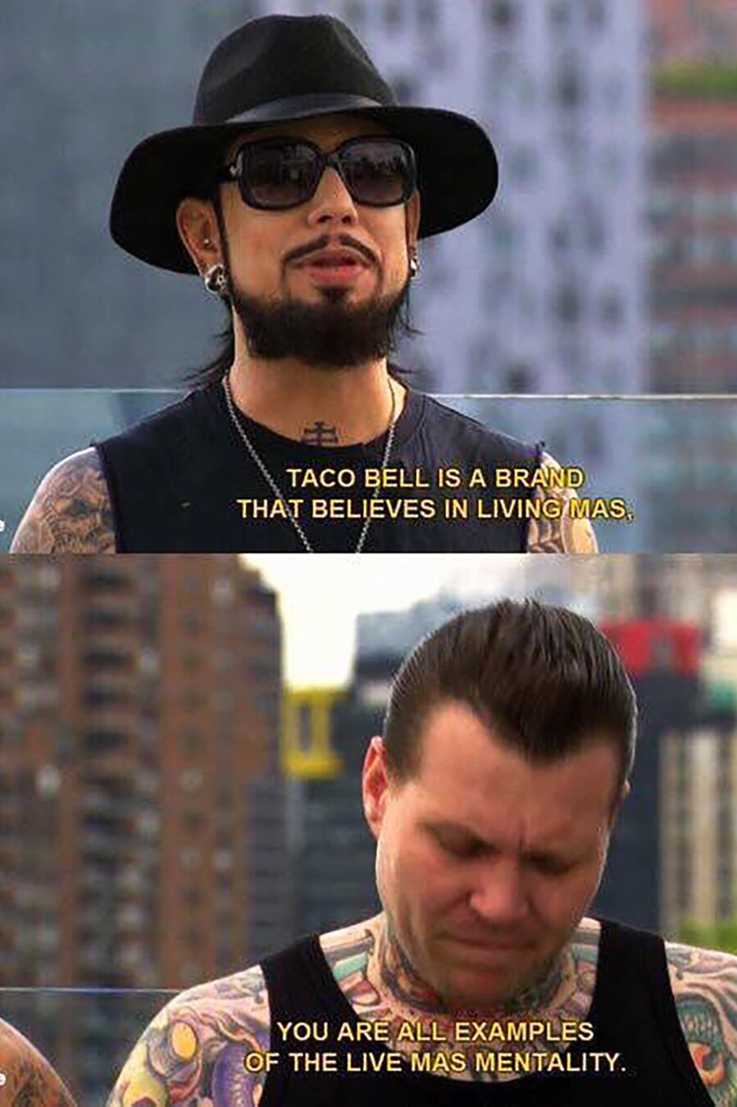
CALLBACK
SHOW
AND LAUGHING AND LOVING
LAUGH LOVE

Slide 9
THE SHOW
CALLBACK isn’t a Musical – it’s a play with songs.
Actually, it’s not really that either – it’s an album with acting.
At the end of the day, what I am most is a songwriter. This is not a musical – it is music.
As all things are

Slide 10
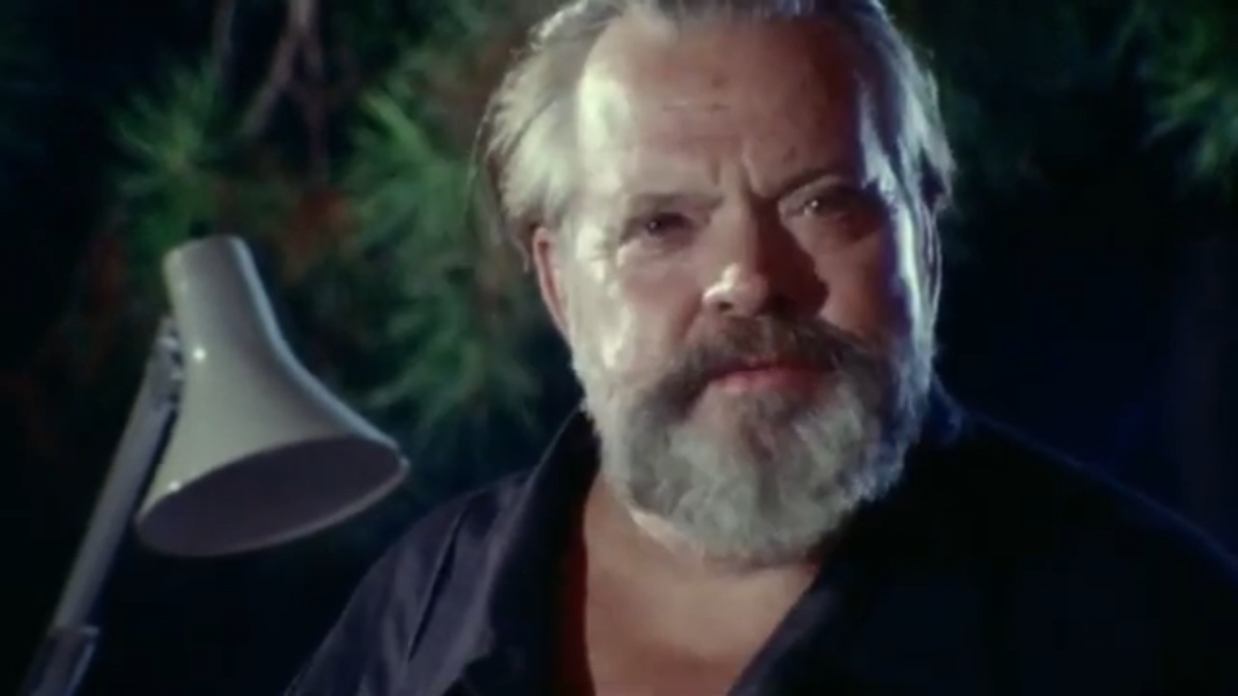

Slide 11
INTENDED AUDIENCE IMPACT
Make them…
Laugh a little more Louder than before Saddled by the weight of time progressing Every stupid moment is a blessing Funny 'cause it's true All there is to do In the face of existential nonsense Is to sop it up before it's gone and... Laugh and live and love All of the above Feel as deep as feelings can be feeling Feel it from the floor up to the ceiling Love and live and laugh Half and half and half Greater than the sum of each component Somewhere in the sum of every moment There's an experience he's desperate to explain It's more than one small dumb audition can contain It's everything, it's life, it's silly, it's profound In grave absurdity, there's meaning to be found Reaching out his hand Hopes they understand He is not expecting adulation All he really wants to do is make them... Laugh and maybe cry Both at the same time He has got to make it happen some way Also he's a mime and so he can’t say Words

Slide 12
YOU GUYS
This is the most important creative endeavor of my life
One way or another, this is going to happen
I really, really want it to go really, really well
I can’t do it alone
I’m trusting you all to help me make it as good as it can be
We’re all in this together once we know that we are we’re all stars and we see that
Welcome to the team

Slide 13
YOU GUYS: CORE TEAM

Slide 14
YOU GUYS: CORE TEAM
Joseph: Director

Slide 15


Slide 16
YOU GUYS: CORE TEAM
Joseph: Director 🫠🫒🛢️👀
Notes:
I don’t know how any of this works. I’m going to be making it up as I go. I’ve got olive oil eyes

Slide 17
YOU GUYS: CORE TEAM
Joseph: Director 🫠🫒🛢️👀
Jonah: Assistant Director
Danny: Music Director / Arranger
Ben: Guitar / Sound
Sarah: Star / Producer
Ali: Producer when she can be

Slide 18
MY PRIORITIES
Have fun
Put on a good show (by our own estimation)
Get people to come to the show
Tangible success (financial, critical)

Slide 19
MY EXPECTATIONS
I try to have faith without expectation but for the sake of everybody I think we should set some
Communication: check Discord at least 1/day
We can work asynchronously as much as possible
Availability: bi-weekly -> weekly -> semi-weekly
Timelines(s): establish and adhere to deadlines

Slide 20
MY PHILOSOPHY
This is all the way DIY
I want it to be a gosh darn blast every second
Breezy perfectionism – try as hard as possible, expect nothing at all
This is going to be a challenge for me, especially if I need to be authoritative
I am going to “no worries if not” my way into a full theatrical production
I am also going to take this way too seriously but it’s also like nbd so don’t even worry about it guys

Slide 21
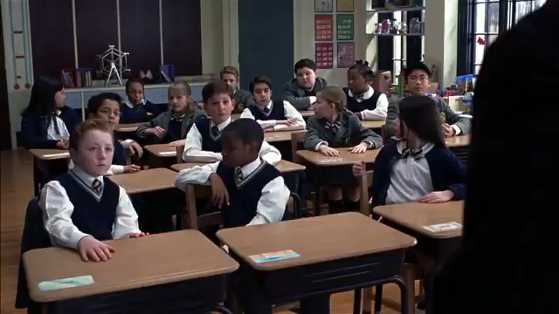
MY PHILOSOPHY CONT’D
This will be an openly collaborative environment
There are no bad ideas
There may be bad decisions
Ultimately, for better or worse, I’m responsible

Slide 22
LET’S GET ROCKIN’!

Slide 23

PRODUCTION TIMELINE
🌠🌠
Auditions
5/25 (?)
Jonah Out
6/2-6/13
Auditions Announced
4/27 (?)
Off-Book
8/1 (?)
PREVIEW
8/14
S
H
O
W
S
Rewrite Done
5/8 (?)
8/29
KICK-OFF
TABLE
READ
6/15 (?)
TECH
7/5 (?)
8/30
DRESS
8/9 (?)
8/10 (?)
now
CHILLIN
8/24-8/29
BIWEEKLY / WEEKLY
6/8-7/20 (?)
SEMIWEEKLY
7/20-8/10 (?)
APRIL
MAY
JUNE
JULY
TECH
7/12 (?)
AUGUST
Cast Set
6/1 (?)
Danny Out
8/15-8/28
Script, Songs, etc
Finalized
7/20 (?)
8/30
Songs Arranged
5/22 (?)
8/31
Sarah Out
8/16-8/23

Slide 24
WHERE DO WE BEGIN
Define the parameters & constraints
Figure out what needs to be done
Figure out what to do next
now

Slide 25
PARAMETERS & CONSTRAINTS
This will be an “independent” production at Imposters.
Showtimes: 7/730, 9/930 (dates set)
Runtime: Stage Reading was 97 mins »
I’m worried about a 930 show if it’s 97 mins + intermission
Michael would prefer 80 mins, but it’s not a hard requirement
Rehearsal Stage Time: Could be difficult to get
We have 2 dress rehearsals and 2 tech rehearsals
Could do more in the basement, other locations, or off-hours

Slide 26
BUDGET
This will likely not result in a life-changing financial windfall
Theoretical Max Revenue: $2,100
4 shows, 50 seats per show, $15 per ticket
Fundraising: Maybe this is something we can do? »

Slide 27
STUFF WE GOTTA DO

Slide 28
WARDROBE, SET DESIGN, CHOREO
Idk how to do such things »

Slide 29
AUDITIONS & CASTING
Never been on either side of this before
Want to be fair AND want to cast the best people for roles
We have a lot of Stage Reading people
We can use Imposters for auditions
Possible dates: 5/25, 6/1
We could cast some people ahead of time, do it in waves
I think this is our first priority! »

Slide 30
REHEARSAL SCHEDULE
Scheduling is the biggest impediment to collaborative work ☹
Preview + Shows are must-make
Tech + Dress rehearsals are must-make
My plan:
Find dates that work for majority of our core team »
Only cast/recruit people who can make those dates work
Try to get them on the calendar as soon as possible!

Slide 31
SONG ARRANGEMENTS
DANNY!
I want Danny to be in charge if Danny is willing to be in charge. I want everyone else to contribute! »
I’d love to have singing parts ready before casting. I also have no idea how to express the written parts other than demos.
I also want to create backing tracks for practice (and maybe an original cast recording)

Slide 32
MARKETING / PROMOTION
You know I’m going to go nuts with the promo
I am going to make like 3 websites
Also some videos probably
Also maybe getting on tv

Slide 33
REWRITE
I want to have a “rehearsal script” ready before auditions happen and definitely by the time of a kick-off table read
Already in-progress – would love to discuss further »
Theoretically the rehearsal script could be the final script, but I want to leave room for potential punch-ups and small edits

Slide 34
EXPANDING THE CORE TEAM
Before actual casting, there may be other people that could help from the production side. Without knowing what casting, availability, and/or interest would be – here are some ideas:
Jack – wrote a bunch of great piano parts!
Griffin – has a cajon!
Cam – talented + inside Imposters + cares about the show!
Katie – literally educated and also just generally fabulous!
Ben P – tech director at Imposters! Will be involved!
Stage Manager – could be good to have!
We can talk about these! »

Slide 35
NEXT STEPS
Figure out audition / casting details
Potentially recruit other crew members
Finish Rewrite
Maybe have a writer’s room
Arrange the songs
Maybe have a writer’s room
Start to schedule things

Slide 36
DISCUSSION TIME

Slide 37
DISCUSSION ITEMS: REWRITE
Cutting time = cutting two songs 😢🪦
Moving “That’s Showbiz” before “Best of All Time (Reprise)
Cutting some lines | Adding some jokes | Some clarity items
Current version of script!
Character bible?
Scheduling a writer’s room
Thoughts on locking the script by the time of the table read?

Slide 38
DISCUSSION ITEMS: ARRANGEMENTS
Not sure who we will have – maybe one guitar, one keyboard, one extra (keytar?) and possibly percussion (Griffin?)
No idea how to transcribe
Maybe divvy up songs? I need to add notes too maybe
Schedule a time for this?

Slide 39
DISCUSSION ITEMS: PRODUCTION
Anyone want to take the lead on set design, wardrobe, choreo?
Should this be an additional crew thing?

Slide 40
DISCUSSION ITEMS: FUNDRAISING
Patreon? Ideas for things?
Demos, podcasts, behind-the-scenes stuff
Bake sale? House show?
Merch?
Shirts that say “Comedy” or “Laugh & Live & Love”

Slide 41
DISCUSSION ITEMS: ADD’L CREW
How do we feel about people?

Slide 42
MAIN DISCUSSION: AUDITIONS
People to discuss from the stage reading?
How should auditions work? Acting, singing, chemistry
Actually scheduling them – I’d like to announce with a month notice if possible
Callbacks??????

Slide 43
WRT: LET’S SCHEDULE BABY
Get some potentials that work for us, send to Michael to see what we can get on the stage

Slide 44
IDEAS
Record the show
3 camera setup (need at least 2 camera people)
audio out through the board, multi-track (need mics)
Record an album as part of arranging songs / practicing
Patreon / podcast / fundraiser house show / “Comedy” shirts
This is a show that gets better the longer it steeps

Slide 45
MAY Core Team Work | JUNE Full Team Pre-Work | JULY Lock In, Baby | AUGUST Practice & Execute

Slide 46
CLEAR EYES, CLEAR HEARTS, CAN’T LOSE
Thank you

Slide 47
CALL
BACK

